Slide 1
Welcome to Marketing Management
Dr. Cecilia Ruvalcaba
BUSI 107 Week 3, Day 2

Slide 2


Slide 3
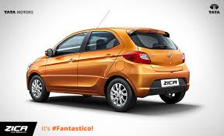

Notes:
India's Tata Motors to rename hatchback that sounds like Zika
http://www.bloomberg.com/news/articles/2016-02-02/zika-outbreak-prompts-tata-motors-to-change-hatchback-model-name

Slide 4

ZMET Qualitative Research
Understanding Consumer’s Mental models through the Zmet technique
Notes:
ZMET (6:35) https://www.youtube.com/watch?v=blQ0U50c1xs

Slide 5

What is ZMET?
What?
A method for mapping consumer’s mental models.
Why?
To understand the personal relevance of a product, service or brand from the consumers’ perspective.
Theory:
Unconscious Tacit Content -> Metaphors
Thoughts are Image Based -> Images for Communication
How?
Metaphor Elicitation
Interviews

Slide 6

Why Mental Models?
Mental Models Include:
Beliefs, attitudes, emotions and feelings, symbols, actions, goals, personal values, images, memories of past consumption events, consumption visions of anticipated experiences, and representations of sensory experience such as touch, taste, and smell.
Can give insight into such questions as:
What do customers know about my brand or product?
What do people think about when they consider buying a brand in my product category?
How does my product fit into the lives of these consumers?
Why is my product important to these customers?

Slide 7

How is it Done?
Collage- Ask participants to:
1) Think about the product/service
2) Select pictures which represent their thoughts and feelings about the product/service
Interview
Respondents discuss their thoughts and feelings represented by each of the pictures they brought to the interview
Probe for thorough elaboration of metaphor
Attribute (Why?) -> Consequences, Value
Use reflexive techniques to ensure comprehensiveness
Analysis

Slide 8
Chapter 5: Analyzing the Marketing Environment

Slide 9
A Marketing Environment Analysis Framework
Culture
Demographics
Company
Consumers
Political/ Legal
Social
Immediate Environment
Corporate Partners
Competition
Macroenvironment
Economic
Technology

Slide 10


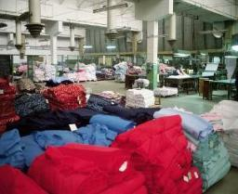

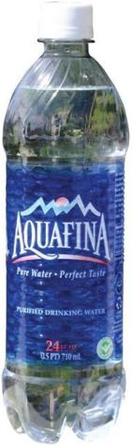
COMPANY: Successfully Leveraging Company Capabilities
Competitor
Know strengths & weaknesses
Proactive rather than reactive strategy
Core competency
Existing knowledge, facilities, patents, etc.
CORPORATE PARTNERS
applied to
New markets, new products, etc.
From factory to Retailer

Slide 11
Macroenvironmental factors
Culture
Demographics
Consumers
Political/ Legal
Social
Economic
Technology

Slide 12
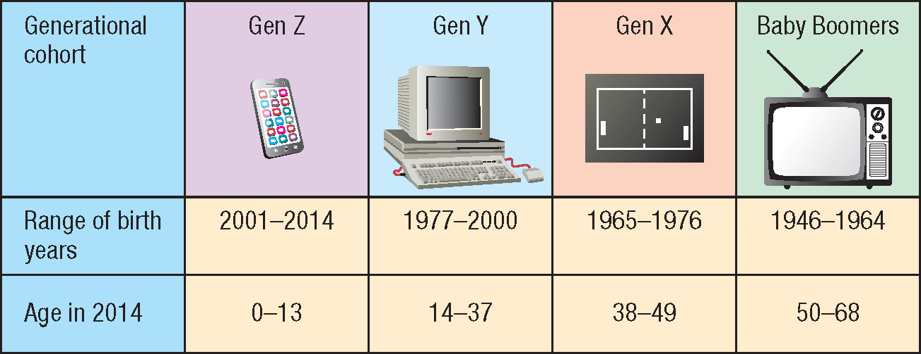
Generational cohorts

Slide 13


Take Away for Today
A Good Marketer is a Vigilant Marketer:
Opportunities arise as the external environment changes.
Who is your customer?
In order to understand your customer, you must understand their environment.

Slide 14

Next Class
Chapter 5: Analyzing the Marketing Environment cont…
Groups
Friday 2/12/16:
Submit Topic & Group Name
Wednesday February 22.
Library Database Session w/ Jack Schroeder

